Slide 1
CHAPTER 10
Object Oriented Analysis and Design

Slide 2
Management of object-orient software projects
Greater resilience to change :
Increased degree of re-use:
Complex system is divided into different subsystem:
Improved Quality :

Slide 3
Object-Oriented Analysis
The Booch method: macro & micro development
The Rumbagh method: object modelling technique
The Jacobson method: Object Oriented Software Engineering (Use Case)

Slide 4
Unified Approach to OOA
Over the past decade, Booch, Jacobson & Rumbagh have collaborated to combine the best features of their individual object-oriented analysis and design into a unified method.
UML allows a software engineers to express an analysis model using a modeling notation that is governed by a set of syntactic, semantic rules.

Slide 5
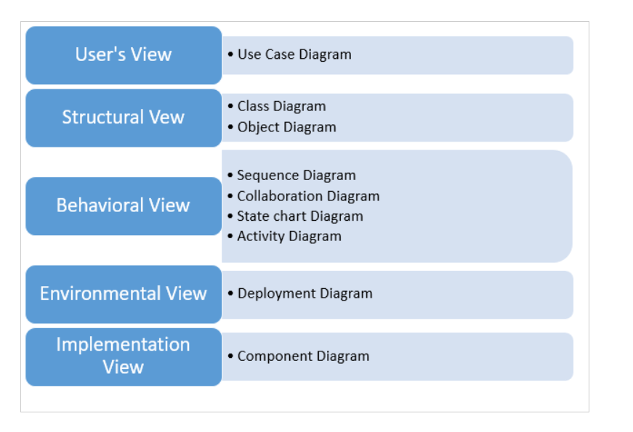
UML View

Slide 6
Domain Analysis
Analysis for object-oriented systems can occur at many different levels of abstraction.
Domain Analysis falls under the middle level of abstraction.
Domain analysis is performed when an organization wants to create library of reusable classes.
The objective of domain analysis is to define a set of classes which can be reused in many applications

Slide 7
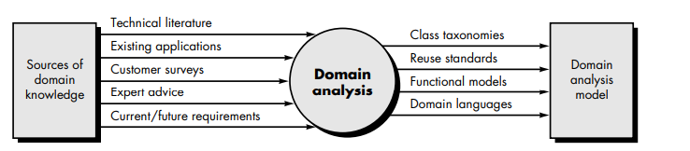
Domain Analysis Process
The goal of domain analysis is to find or create classes that are broadly applicable so that they may be reused.
Figure: Input and output process for domain analysis

Slide 8
Domain Analysis Process
The domain analysis process can be characterized by a series of activities:
Define the domain to be investigated
Categorize the items extracted from the domain.
Collect a representative sample of applications in the domain
Analyze each application in the sample.
Develop an analysis model for the objects.

Slide 9
GENERIC COMPONENTS OF THE OO ANALYSIS MODEL
Static components do not change as the application is executed.
Dynamic components are influenced by timing and events
Static components are structural in nature
Dynamic components focus on control and are sensitive to timing and event processing
Key components of OOA model
Static view of classes
Static view of attributes
Static view of relationships
Static View of behaviors
Dynamic view of communication
Dynamic view of control and time

Slide 10
THE OOA PROCESS
The OOA process does not begin with a concern for objects. Rather, it begins with an understanding of the manner in which the system will be used
series of techniques that may be used to gather basic customer requirements and then define an analysis model for an object oriented system are given below
Use Cases
Class Responsibility Collaborator Modelling
Defining Structures and Hierarchies
Defining Subjects and Subsystems

Slide 11
Use-case
Use-case model the system from the end-user’s point of view.
Created during requirements elicitation,
use-cases should achieve the following objectives:
• To define the functional and operational requirements of the system that is agreed upon by the end-user and the software engineering team.
• To provide a clear and unambiguous description of how the end-user and the system interact with one another.
• To provide a basis for validation testing

Slide 12
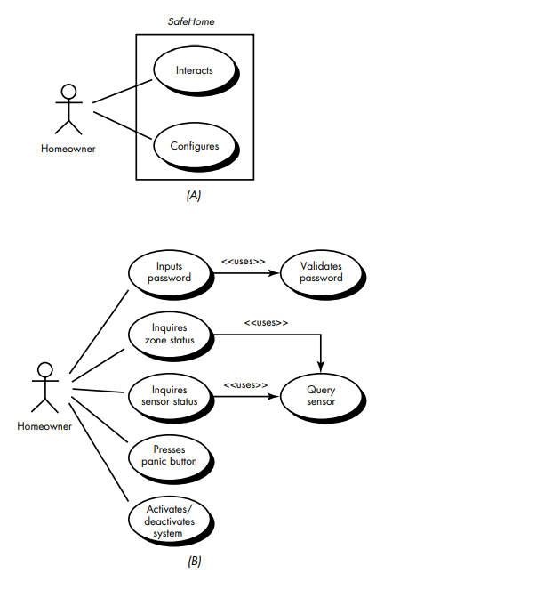
Use-Cases

Slide 13
Class-Responsibility-Collaborator Modeling
Once basic usage scenarios have been developed for the system, it is time to identify candidate classes and indicate their responsibilities and collaborations.
Class responsibility-collaborator (CRC) modeling provides a simple means for identifying and organizing the classes which are relevant to system or product requirements.

Slide 14
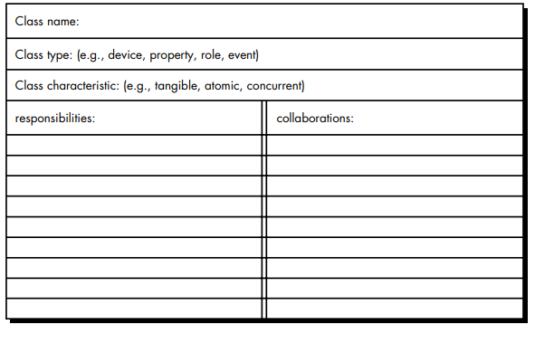
Class-Responsibility-Collaborator Modeling

Slide 15
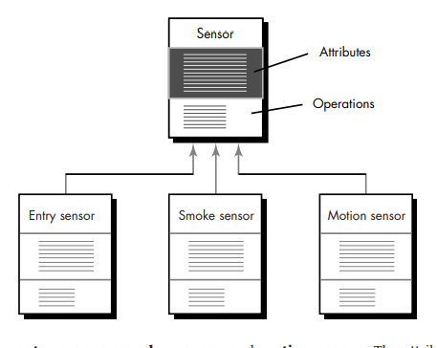
Defining Structure and Hierarchies
Class diagram for generalization

Slide 16
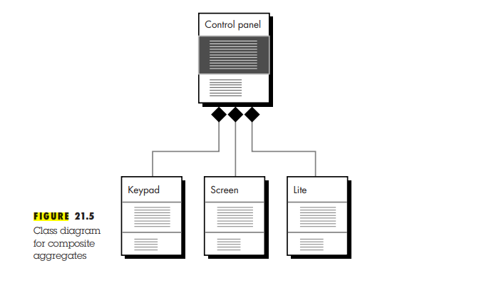
Defining Structure and Hierarchies

Slide 17
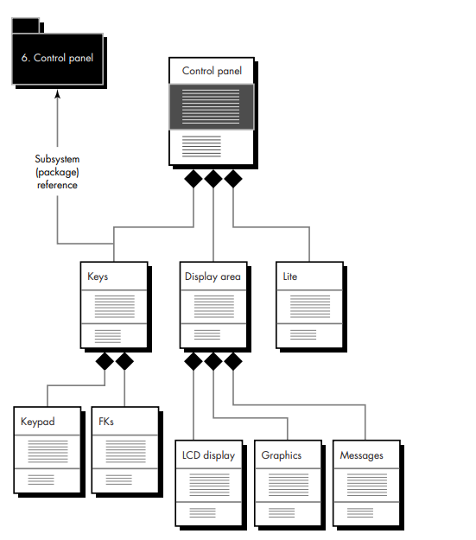
Defining Subjects and Subsystems

Slide 18
OBJECT ORIENTED DESIGN
During the object oriented design there is an emphasis on defining software objects and how they collaborate to fulfill the requirements.
Object-oriented design transform the analysis model created using object-oriented analysis into a design model that serves as a blueprint for software construction

Slide 19
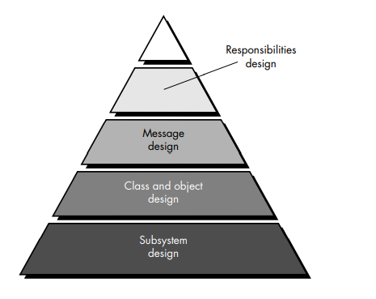
Layers of OO design Pyramid

Slide 20
Layers of OO design Pyramid
The subsystem layer: contains the representation of subsystems helps to achieve its customer-defined requirements
The class and object layer contains the class hierarchies. This layer also contains representations of each object
The message layer contains the design details that enable each object to communicate with its collaborators. This layer establishes the external and internal interfaces for the system

Slide 21
Layers of OO design Pyramid
The responsibilities layer contains the data structure and algorithmic design for all attributes and operations for each object

Slide 22
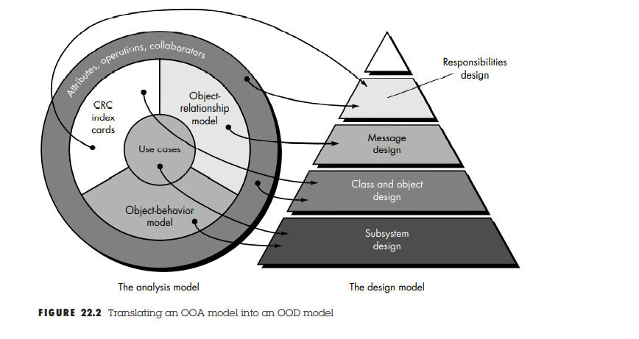
Translating OOA model to OOD model

Slide 23
Translating OOA model to OOD model
The subsystem design is derived by considering overall customer requirements (represented with use-cases) and the events and states that are externally observable (the object-behavior model).
Class and object design is mapped from the description of attributes, operations, and collaborations contained in the CRC model.
Message design is driven by the object-relationship model,
Responsibilities design is derived using the attributes, operations, and collaborations described in the CRC model

Slide 24
DESIGN PATTERNS
Design patterns allow the designer to create the system architecture by integrating reusable components.
There are many recurring patterns of classes and communicating objects in many object oriented systems.
Throughout the OOD process, a software engineer should look for every opportunity to reuse existing design patterns rather than creating new ones.

Slide 25
Describing a Design Pattern
All design patterns can be described by specifying the following information
the name of the pattern
• the intent of the pattern
• the “design forces” that motivate the pattern
• the solution that mitigates these forces
• the classes that are required to implement the solution
• the responsibilities and collaboration among solution classes
• guidance that leads to effective implementation
• example source code or source code templates
• cross-references to related design pattern

Slide 26
Using Patterns in Design
In an object-oriented system, design patterns can be used by applying two different mechanisms:
Inheritance
composition

Slide 27
Using Patterns in Design
Composition
Composition is a concept that leads to aggregate objects.
That is, a problem may require objects that have complex functionality

Slide 28
Using Patterns in Design
Inheritance
Using inheritance, an existing design pattern becomes a template for a new subclass.
The attributes and operations that exist in the pattern become part of the subclass

